Slide 1

Github Workflow
Introduction to Practical Usage of Github
MED 2 Programming For Interaction

Slide 2
Agenda
Daily workflow
How to Collaborate
Git Flow
Good OOP practices

Slide 3
Your Daily Git Workflow

Slide 4

Your Daily Coding Workflow
Get Latest Changes
Work on features
Update Remote Repository

Slide 5
1. Get Latest Changes
When you start working for the day, you need to make sure that your local repository has the most recent changes from the remote
Pull
Make sure you have the newest changes before doing anything
Fix conflicts
Ideally there will be none, but that is not always the case

Slide 6
2. Work on features
This is your main loop for the day.
Write Code
Write your code.
Test and debug, and make sure it is working as intended before proceeding.
Commit
Make regular, small commits
Make sure to use a short but descriptive commit message

Slide 7
3. Update Remote Repository
Now that you are finished working for the day, it is time to update the remote repository with your changes.
Pull
In the time that you have been working, someone else may have pushed changes to the remote. Once more, pull the most recent changes
Fix conflicts
Again, there are hopefully no conflicts, but you can be unlucky (or not have followed the workflow properly)
Push
Once you have fixed the conflicts, you are ready to push your changes. If you are working in a very high-pace environment you may with to repeat the previous two steps until you can pull with no conflicts.

Slide 8
How To Collaborate

Slide 9
How to Collaborate
Plan!
Design your code before you write it
Discuss with your team, and make UML to get the ideas clear
Do not work on the same files
This causes merge conflicts
Unfortunately git does not by default allow you to “lock” files like some VCS (e.g. SVN)
Only commit and push files that you have changed
You may have some files that have been “changed” that you are not sure about. If you did not change them intentionally, then you probably do not need to commit and push them.
Consider adding files that repeatedly appear to your .gitignore

Slide 10
Git Flow
A Git Branching model for Continuous Development

Slide 11
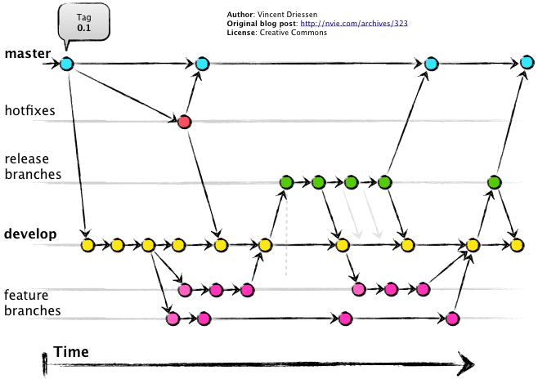
Git Flow
master- this branch holds your most recent release (i.e. working version)
dev – this is your work-in-progress
feature – create feature branches for each new change in the project.
branch off and merge into dev
release – prepare a release candidate.
branch off dev, merge into dev and master
hotfix – when a problem arises in your release, you need to fix it
branch off master, merge into dev and master

Slide 12
Git Flow: Should I use it?
Git flow is likely overkill for smaller projects
CI is similar to Iterative development used in many Medialogy projects
Having access to a functioning prototype on master while making changes in dev is very valuable.
You likely don’t need to use the whole toolset
Find what works for you and your group

Slide 13
Object Oriented Programming TIPs
Your code should be DRY and SOLID
The more granular your code is, the easier it is to collaborate
It also becomes easier to make changes without breaking everything

Slide 14
DRY
Don’t Repeat Yourself
When you find yourself re-writing code, you are making your code prone to error
Any changes to this code need to happen in many places
Keep it in one single place, and changes there will trickle down to where it is needed.

Slide 15
SOLID
SOLID is a set of 5 principles for writing good OOP code.
Some are more complicated than others, and touch on things you haven’t studied yet. But the principles are very helpful

Slide 16
SOLID
Single Responsibility Principle
Open-Closed Principle
Liskov Substitution Principle
Interface Secregegation Principle
Dependency Inversion Principle

Slide 17
SOLID – A gross oversimplification
Single Responsibility Principle
Use small classes with clear purposes
Open-Closed Principle
Make use of Polymorphism
Liskov Substitution Principle
Refer to subclasses by their superclasses when possible
Interface Secregegation Principle
It’s better to have many small interfaces than a few large ones
Dependency Inversion Principle
Separate Data and Logic in your code

Slide 18
Wrap Up
Workflow:
Always Pull new changes first!
Make regular commits (with clear messages)
Collaboration
Have a clear plan (UML helps)
Avoid working in the same file as others
Commit only what you know you changed
Test before pushing!
Best Practices
Following good OOP practices makes it easier to code together
Use many small classes and interfaces
The more files you use, the less likely you are to work in the same file as others
Use polymorphism
The less you have to change old code, the better
Pull again before pushing (someone else might have pushed changes)

Slide 19

Questions?

